Slide 1
Reddit Analysis - Machine Learning
Group 1 - Amila Mevic, Ayush Shah, Seda Aydinoglu, Taulant Krasniqi

Slide 2

Project Summary
Using a Reddit screener
Subreddits analyzed : r/wallstreetbets and r/stocks to get the top 5 mentioned stocks for that day
Running sentiment analysis on that data to determine if it is a buy or not buy.
Tickers are pulled from yfinance api to get the ticker price
Running technical indicators on the data to create the data frame for the machine learning models and predicting if it is a buy or not buy.
Notes:
We decided to use the reddit api to go through and screen the comments within the two well known stock subreddits - wallstreetbets and stocks. The function we utilized went through the ‘hot posts’ for that day and searched the posts for the most mentioned tickers and we chose to limit that to the top 5 tickers and those change daily.
The function then ran sentiment analysis to see whether the mentions were positive or negative and how reddit users feel about that particular stock, to then determine if the stock is a buy or a not buy.
To create our machine learning model, we uitlized the yahoo finance api to retrieve the stock data for the past 180 days and then ran our technical indicators to create a dataframe for our linear regression and decision tree models so that we can determine if the reddit stocks were actually a good buy or not.
The idea was to not put all our trust into what reddit users are saying and to actually run technical analysis on the data.

Slide 3

Data Screener
Identify trending stocks along with sentiment of each ticker to capitalize on buy opportunities
Reddit and PRAW API
Scans for Daily and Weekend Discussion on “WallStreetBets” and “Stock” subreddits for live changes
Mega Cap stocks over $3.00/Share considered
Extracted text from Subreddit comments and by each Ticker/Stock values
Ranked each of the trending stocks throughout Reddit
Filtering out and collect the top 5 most mentioned stocks
Vader Sentiment Analysis
Classify comments for each of the top trending stocks
Score and graph the stocks based on sentiment as Bullish, Bearish, or Neutral
Compound Score > 5.00%

Slide 4
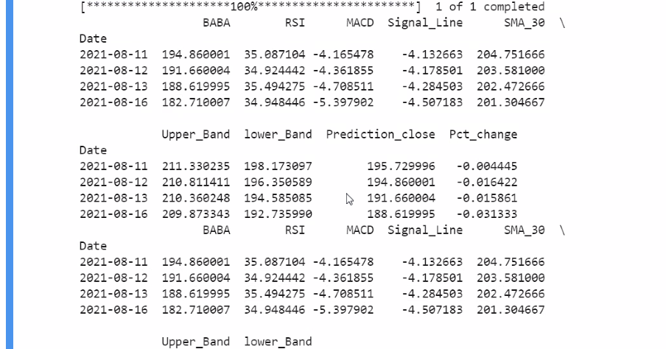
Technical Indicators
Once we get the stock data features from yahoo finance then we run our technical analysis to create a dataframe for a machine learning model.
The indicators applied are;
RSI
MACD
SMA(30)
Bollinger Bands
Notes:
What we can talk about the data cleanse part. ?
1 - RSI stands for relative strength index and it is an indicator that we apply our stock charts to identify overbought or oversold markets.
2 -Divergence is when stock price is moving in the opposite direction of the rsi indicator , we can look at it as an early indication of a possible trend change.
3 - MACD Indicator :A macd indicador usually looked for to find buy/sell signals. It is typical settings are 12,26,9 and there is also a zero line “0” which is middle the line to indicate if the trend is up the trend is down.
The first line that gets plotted is using 12,26 EMA(Exponential moving averages) which is a MACD line calculated by subtracting the 26 EMA of the price from the 12 day EMA of the price. The second line that gets plotted is called the signal line which is 9 day moving average of the MACD line to smooth out fluctuations of the price movement and it lags behind. When MACD line crosses down the signal line it is considered a sell signal. When MACD line crosses up the signal line it is a buy signal.
And also when we use MACD indicator we look at the histogram which tells how close these 2 lines are to cross over. We can do a second guess by looking at the histogram’s direction.
4- Bollinger bands are techn ical indicator that can help us define the trends and measure the volatility of the stock.
Why we are using those indicators. 5 different signals and create df for a machine learning model

Slide 5
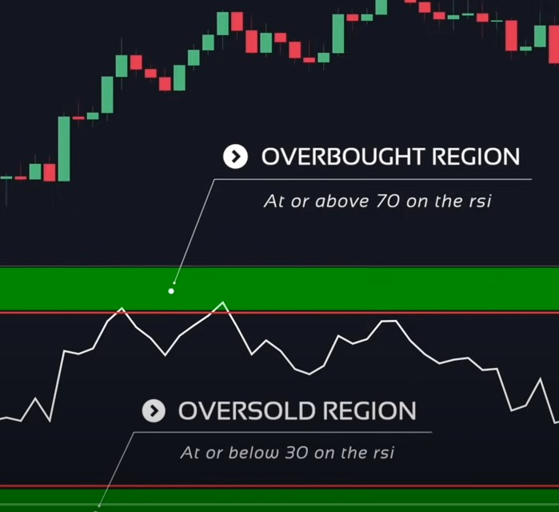
RSI
RSI stands for relative strength
index and it is an indicator that we
apply our stock charts to identify
Overbought (Rsi is over 70 =
sell signal)
or oversold (Rsi under 30 = buy
signal) levels.
.

Slide 6
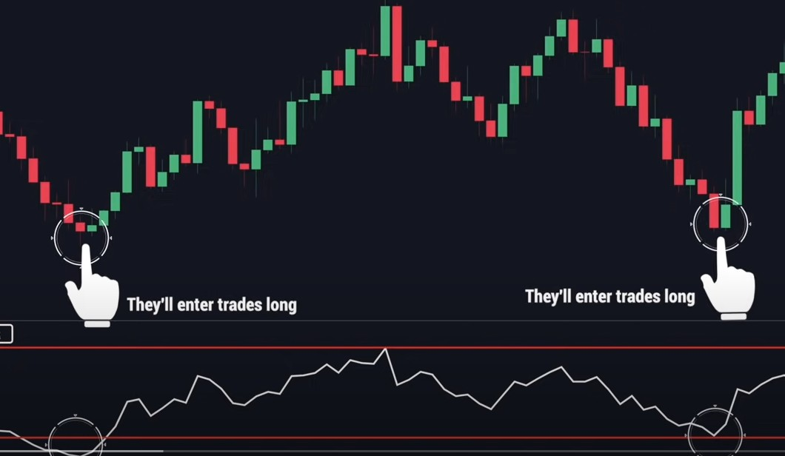
Rsi signals

Slide 7
MACD Indicator
3 - A macd indicador usually looked for to find buy/sell signals.
It is typical settings are 12,26,9 and there is also a zero line “0” which is middle the line to indicate if the trend is up or down.
The first line that gets plotted is using 12,26 EMA(Exponential moving averages) which is a MACD line calculated by subtracting the 26 EMA of the price from the 12 day EMA of the price. The second line that gets plotted is called the signal line which is 9 day moving average of the MACD line to smooth out fluctuations of the price movement and it lags behind. When MACD line crosses down the signal line, it is considered a sell signal. When MACD line crosses up the signal line it is a buy signal.
And also when we use MACD indicator, we look at the histogram which tells how close these 2 lines are to cross over. We can do a second guess (early trend reversion) by looking at the histogram’s direction

Slide 8
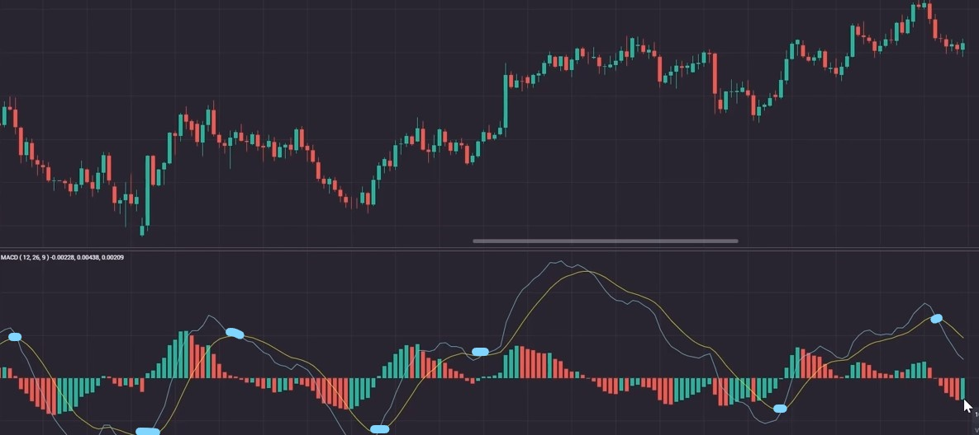
Macd Indicator Sample

Slide 9
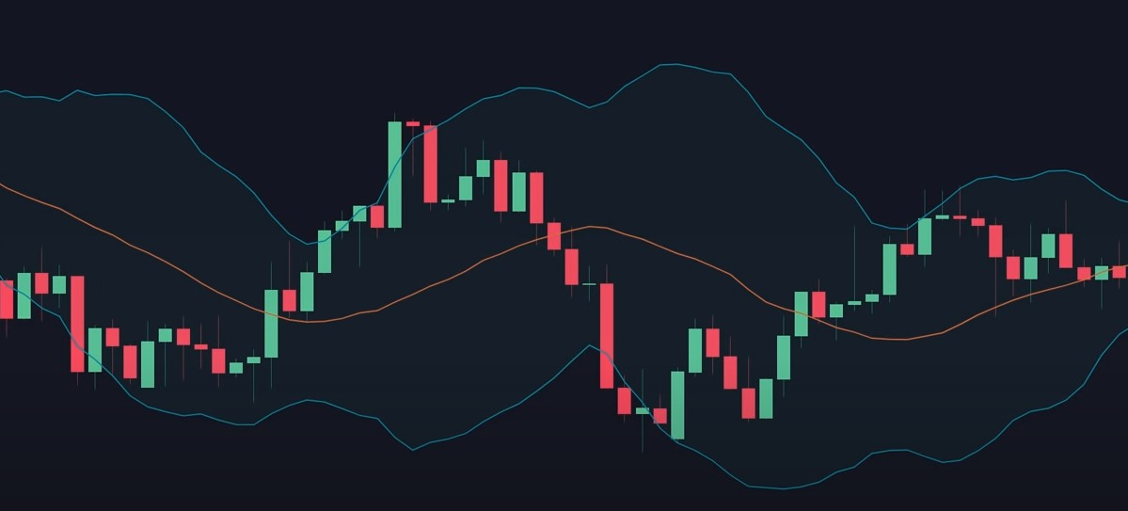
Bollinger Bands
They are technical indicators
that can help us define
the trends and measure
the volatility of the stock.
The bands are calculated
using the standard deviation
from a moving average.
SMA20 or SMA30 etc.
They are plotted as 2
Standard deviations above
And below from a moving
Average.
It is helpful to
measure volatility of the returns
from a historical average or mean,
because we think %95 of stock”s
Historical price movement will stay in
These 2 bands.

Slide 10
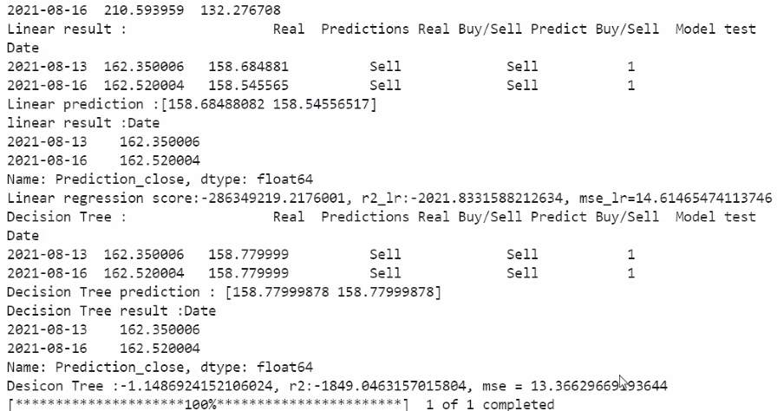
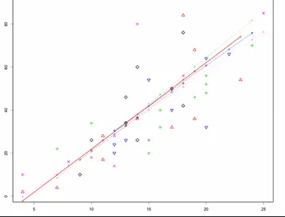
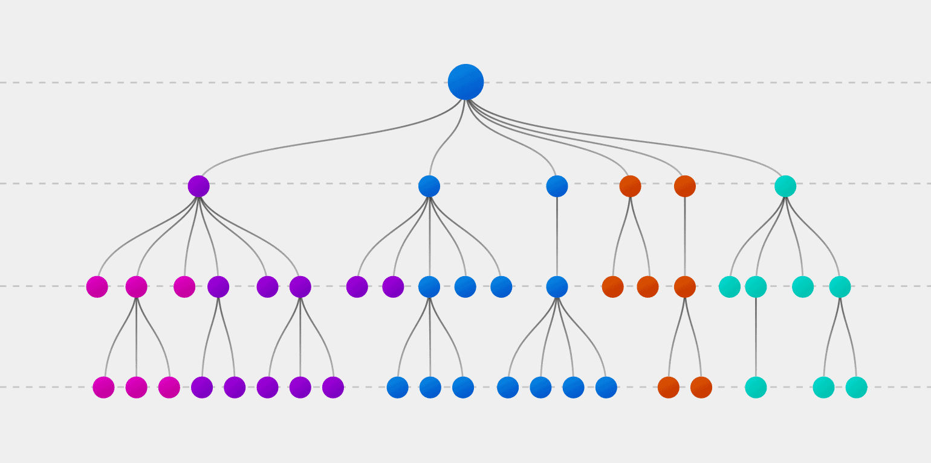
Model, Evaluation, and Performance
We are using linear regression and Decision tree model for predicting buy or not buy.
Notes:
Since the data is time series continus data we are using supervise learning model linear regression and decision tree to predict whether reddit mention stock is good buy or not. For linear regression we are using target brach return and for decsicon tree model using the future close price for target branch.

Slide 11
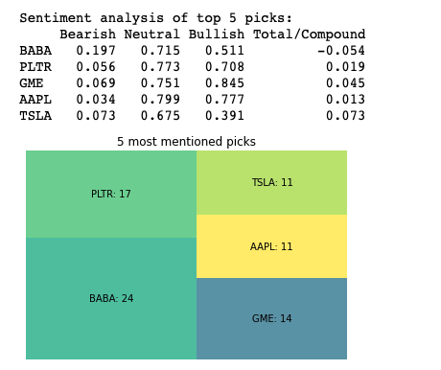
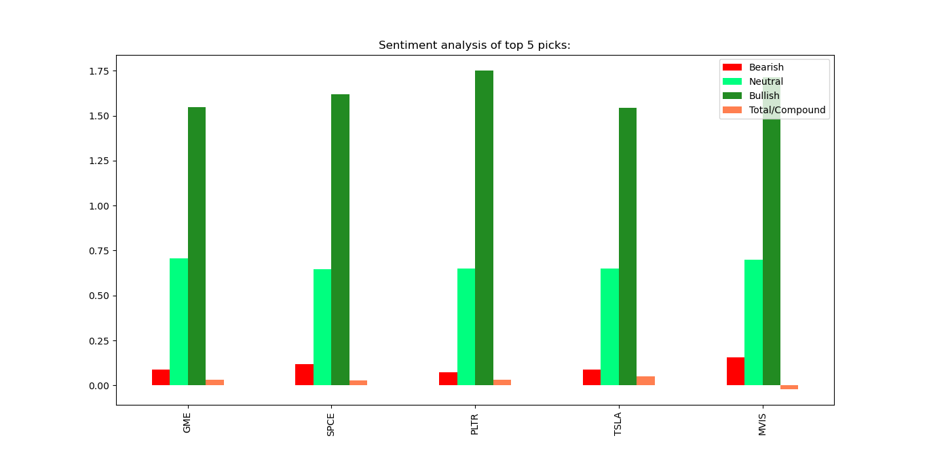
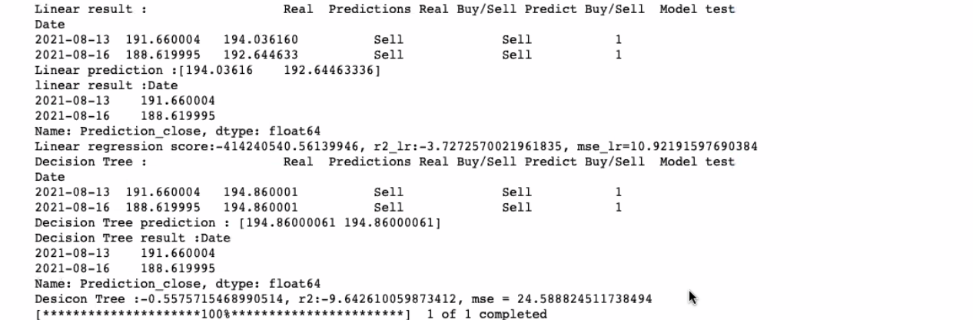
Visualizations

Slide 12
Key Findings
Not all of the stocks are certain buy just because they gained popularity on that day had mentioned too much on Reddit wallstreetbets and stocks.
Even though some of the stocks we analyzed were a ‘sell’, we still need to consider that reddit and it’s community has influence over the stocks and how well they do.
By looking at our sell signals We can identify bubble of a certain stock and we can able put a short position on that.

